Slide 1
Reminders
Midterm 2 will be next Tuesday, 10/30
Today I’ll give a study guide/brief in-class review after chapter 18
This test will be a little different, hopefully in a good way
Work as much in class as you can (no books/notes)
Then, take it home. Open book/note, don’t work together
Due following Tuesday, 11/6
Extra credit (5% toward final grade) Three College Observatory visit nights just for A235 students:
Thursday, 11/1; Sunday, 11/4; Monday, 11/5; Thursday, 11/8
Only if clear!! Observatory phone number (336-334-5700) will have on/off announcement by 5:30pm those dates
We will arrange carpools in Petty main foyer at 6pm (~40min drive to TCO). I can only take 3- volunteers with cars much appreciated!
Notes:
Dress warmly, no heat at observatory!

Slide 2
The Bizarre Stellar Graveyard
Chapter 18, The Cosmic Perspective

Slide 3
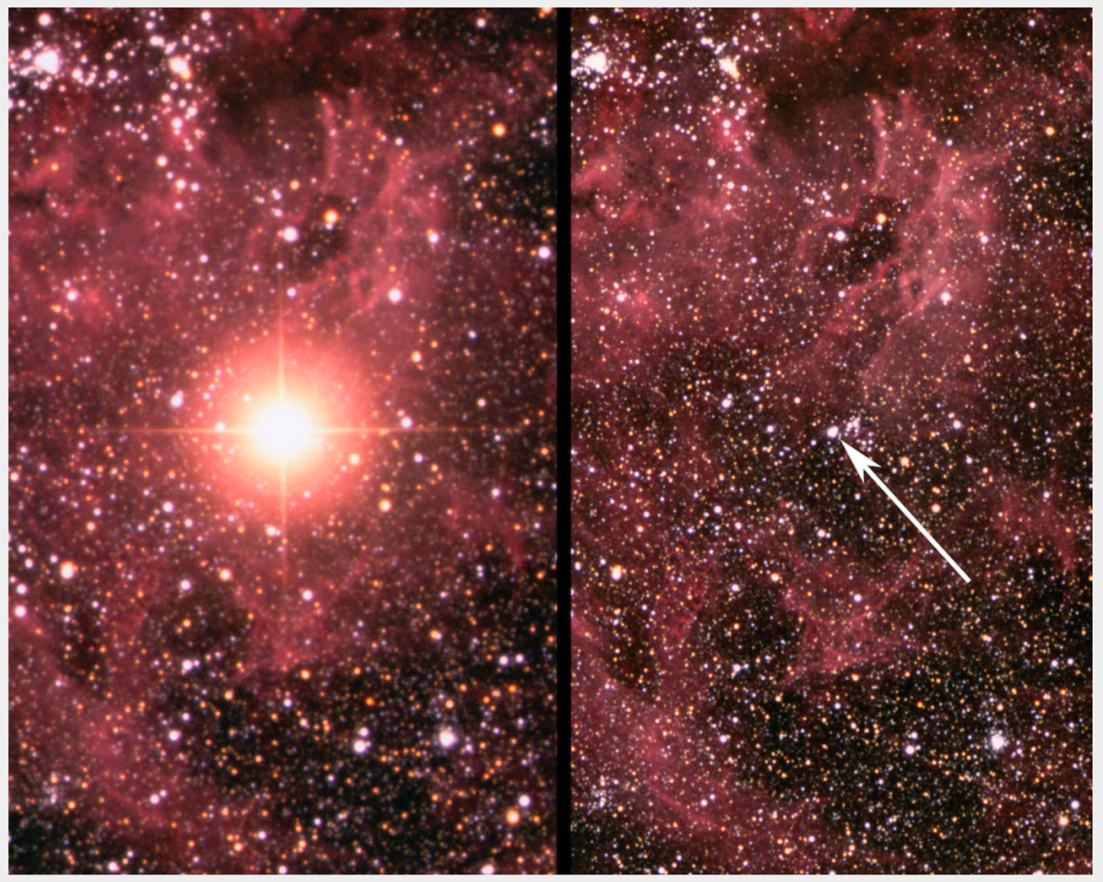
What’s left when fusion stops
Planetary nebulae
White dwarfs
Neutron stars
Supernovae
Black holes
Notes:
Image 1: Supernova 1987A after exploding in February 1987 (left), and an image taken before the explosion (right). Credit: David Malin / Australian Astronomical Observatory.
Image 2: NASA/CXC/ASU/J. Hester et al.^{[1]}
image 3: still from Gargantua simulation, produced for the movie Interstellar: https://io9.gizmodo.com/the-truth-behind-interstellars-scientifically-accurate-1686120318

Slide 4
Recap: summary of stellar lives
Low mass stars (~1M☉)
High mass stars (~25M☉)
11.5 billion year lifetime
protostar,
yellow main sequence star,
red giant star,
helium core-fusion star,
double shell-fusion red giant,
planetary nebula,
white dwarf
6 million year lifetime
protostar,
blue main sequence star,
red supergiant,
helium core-fusion supergiant,
multiple shell-fusion supergiant,
supernova,
neutron star or black hole
Notes:
Pg 550 in the textbook
11.5billion years = 10 months on cosmic calendar
6 million years = 4 hours on cosmic calendar

Slide 5
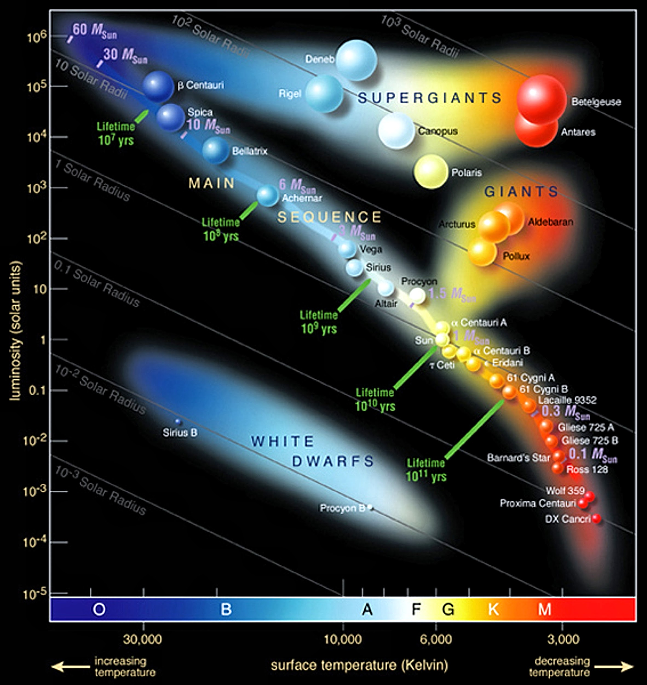
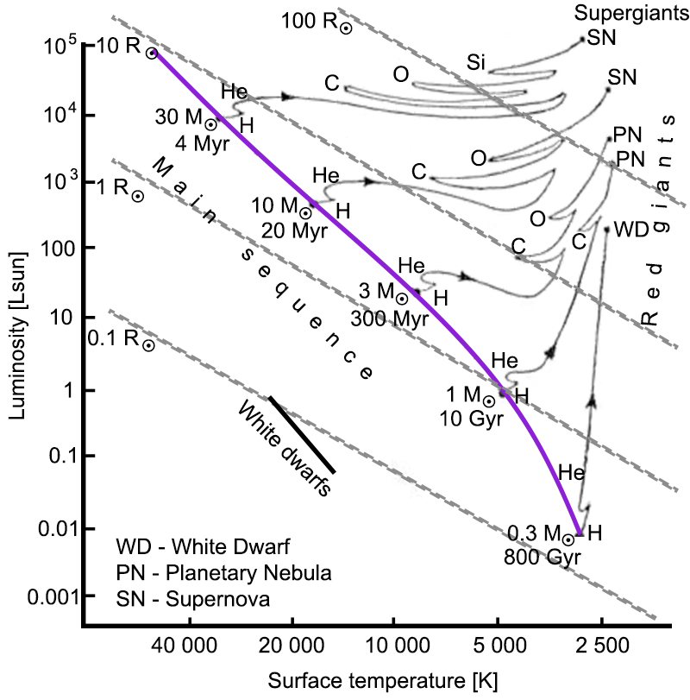
H-R Diagram, in time
Stellar birth → contraction onto the main sequence
Stellar death → expansion off of the main sequence, reignitions of fusion versus gravity
Notes:
I’m going to really lean on some things you’ve already heard a number of times today as a way of reviewing for the test..

Slide 6
Pressure vs. Gravity
Seeking hydrostatic equilibrium state
Fusion, degeneracy pressure push out
Gravity pushes in
Star moves back and forth across H-R diagram as temperature, surface area change
G r a v i t y
Pressure
Notes:
This is really important- most of the rest of class will have to do with the balancing (or not) of pressure and gravity

Slide 7
White Dwarfs
When conditions aren’t hot/dense enough to burn…
Pressure source becomes electron degeneracy pressure
Since it isn’t fusing any more, the light emitted is thermal emission because it’s still hot
White dwarfs gradually cool
(and move along this locus in the H-R diagram)
Radii are about the same as the Earth
More massive white dwarfs smaller in radius
Temperatures typically ~20,000+ K
Notes:
Electron degeneracy pressure is a consequence of the Pauli Exclusion Principle; it’s a resistance to quantum state degeneracy and not an electrostatic repulsion.
Remember that question from the first midterm about stars you can see in a blue filter as well as in a red one, vs one you can see in just the red? This white dwarf example is exactly the same, but the filters are ultraviolet and visible light. The star you can see in the UV and the visible (the white dwarf) is hotter than the star that’s dim in the UV and bright in the visible.

Slide 8
White Dwarfs
Still have absorption lines in their spectra!
A white dwarf’s composition reflects the products of the star’s final nuclear burning stage
The lowest mass stars leave helium white dwarfs
The remnant of a 1 M☉ star contains mostly carbon
Intermediate-mass stars end their lives as oxygen white dwarfs or those containing heavier elements
The mass of a white dwarf cannot exceed 1.44 M☉ – beyond this mass (the Chandrasekhar limit), electron degeneracy pressure can be overcome by gravity
Notes:
So if you observe a white dwarf, you have a pretty good idea what its mass may be.
http://iopscience.iop.org/article/10.1088/0004-637X/719/1/803
In the figure, that lowest spectrum is of a metal-rich white dwarf- astronomers think the metals are from a planet or asteroid-like object the star accreted (ate. Yum, burrp.).

Slide 9
White dwarf novae
If a companion is close enough, white dwarf can accrete material
Fusion can briefly reignite in a shell if enough H accretes, 10 million K temperature reached
Hot, fast, burst of fusion blows the accreted material right off
Accretion can resume, novae could periodically happen
For comparison, novae are ~100,000L☉, supernovae
~10⁹ L☉
Notes:
‘nova’ just means ‘new’
https://www.spacetelescope.org/images/opo9729a/

Slide 10

Supernovae
If electron degeneracy pressure is overcome, electrons combine with protons to become neutrons
In a fraction of a second, an iron core collapses into a ball of neutrons a few kilometers across
The collapse stops, since neutrons have their own degeneracy pressure
Collapse releases a huge amount of energy and results in an explosion – a supernova

Slide 11
Supernovae
Explosion could be driven by a neutrino shock wave, propagating through the star’s outer layers
Some part of acceleration/driving away star’s envelope could be ‘bouncing’ effect of the core
Notes:
http://astrosun2.astro.cornell.edu/academics/courses/astro201/sn.htm

Slide 12
Supernovae
Three types of supernova (depending on how limit is exceeded):
White dwarf (explosion in a binary system)
Accretion
Merger
Intermediate-mass (leaves a neutron star as remnant)
Massive (leaves a black hole as remnant)
Supernovae shine as bright as ~10 billion Suns for a few weeks
The neutron core is called a neutron star
If gravity overcomes neutron degeneracy pressure, the core continues to collapse → black hole
Notes:
Supernova 1987a, observed by HST http://www.spacetelescope.org/images/potw1142a/

Slide 13
White dwarf supernova
Something (two white dwarfs merging, or a white dwarf accreting material from its companion) pushes white dwarf over Chandrasekhar limit
Inert, electron degeneracy pressure-supported C core reaches 600 MK, C ignites
But wait, there’s not enough mass to counteract the outward pressure from C fusing!
Ka-boom!
Because of the magic 1.4 M☉ number, all white dwarf supernovae have comparable brightnesses
If we observe the apparent brightness and know what its luminosity should be, can calculate a distance!

Slide 14
Neutron Stars
Product of intermediate mass stars’ supernovae
A neutron star is created by the collapse of the iron core: electrons and protons combine
Neutron stars are supported by neutron degeneracy pressure
Neutron stars resemble atomic nuclei, but:
are made of neutrons
are held together by gravity
emit photons gravitationally redshifted
photons lose energy overcoming the strong
gravitational field
Notes:
https://phys.org/news/2018-05-spectacular-neutron-star-merger-gravitational.html

Slide 15
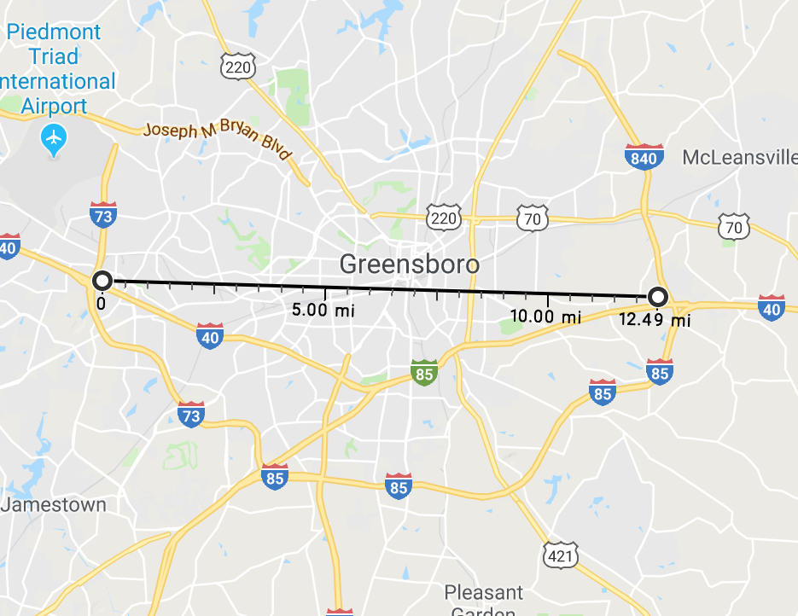
Neutron Stars
Hold on to your hats, these things are bizarre…
Typical size: R ~10 km (~6.21mi)
Mass: M ~1.4 – 3 M☉
Density: ρ ~10¹⁴ g/cm³
→ Piece of neutron star matter of the size of a sugar cube has a mass of ~ 100 million tons!!!
→ A paper clip as dense as a neutron star would weigh more than Mt Everest
Thought to have “crusts” of electrons, ions, near surface where pressure is like a white dwarf

Slide 16
Pulsars
How do we know neutron stars exist?
First detection of a pulsar: Jocelyn Bell, 1967; radio observations
Fast (1.337301 second), regular pulses detected from the constellation Cygnus
Called “LGM-1” (Little Green Man)
1968: More pulsars! Found in Crab, Vela Nebulae, gaseous remnants of supernovae
Notes:
Image: Crab nebula observed with VLT (on page 563 in book)

Slide 17

Story time…
In 1967, Dame Jocelyn Bell Burnell discovered pulsars when she was a graduate student (age 24!)
Her thesis advisor won the Nobel Prize in 1974 for the discovery
He originally thought it was interference from human-produced radio signals, suggested s
Recently, she won the $3 million Breakthrough Prize
Has donated it all to the Institute of Physics to fund studentships (fellowships and scholarships) for physics students from traditionally excluded groups
Notes:
Story time!!! Can you guess what I’m going to tell you about Jocelyn Bell (Burnell)? She discovered something cool, her work wasn’t believed, she continued to work and confirm it, then others got credit for the discovery, she wasn’t acknowledged by Nobel prize committee … story’s getting a little familiar, isn’t it?
https://www.nature.com/articles/d41586-018-06210-w
https://www.theguardian.com/science/2018/sep/06/jocelyn-bell-burnell-british-astrophysicist-overlooked-by-nobels-3m-award-pulsars

Slide 18
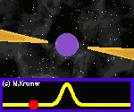
Pulsars
Found at the centers of supernova remnants: A-ha!
Pulsations are due to rapid spinning of the neutron star (angular momentum conservation!)
Pulsars also have extremely strong magnetic fields.
The magnetic field directs beams of radiation out along the magnetic poles.
Pulsars slow down with time
All pulsars are neutron stars, but not all neutron stars are pulsars
Notes:
http://www.atnf.csiro.au/outreach/education/senior/astrophysics/stellarevolution_deathhigh.html

Slide 19

Pulsars - examples
PSR B0329+54
PSR B0531+21, The Crab Pulsar
Period 0.714519 seconds, i.e. close to 1.40 rotations/sec
Rotates about 30 times a second
Credit: Dawn Erb (found on Thingiverse)
Notes:
http://www.jb.man.ac.uk/pulsar/Education/Sounds/sounds.html

Slide 20
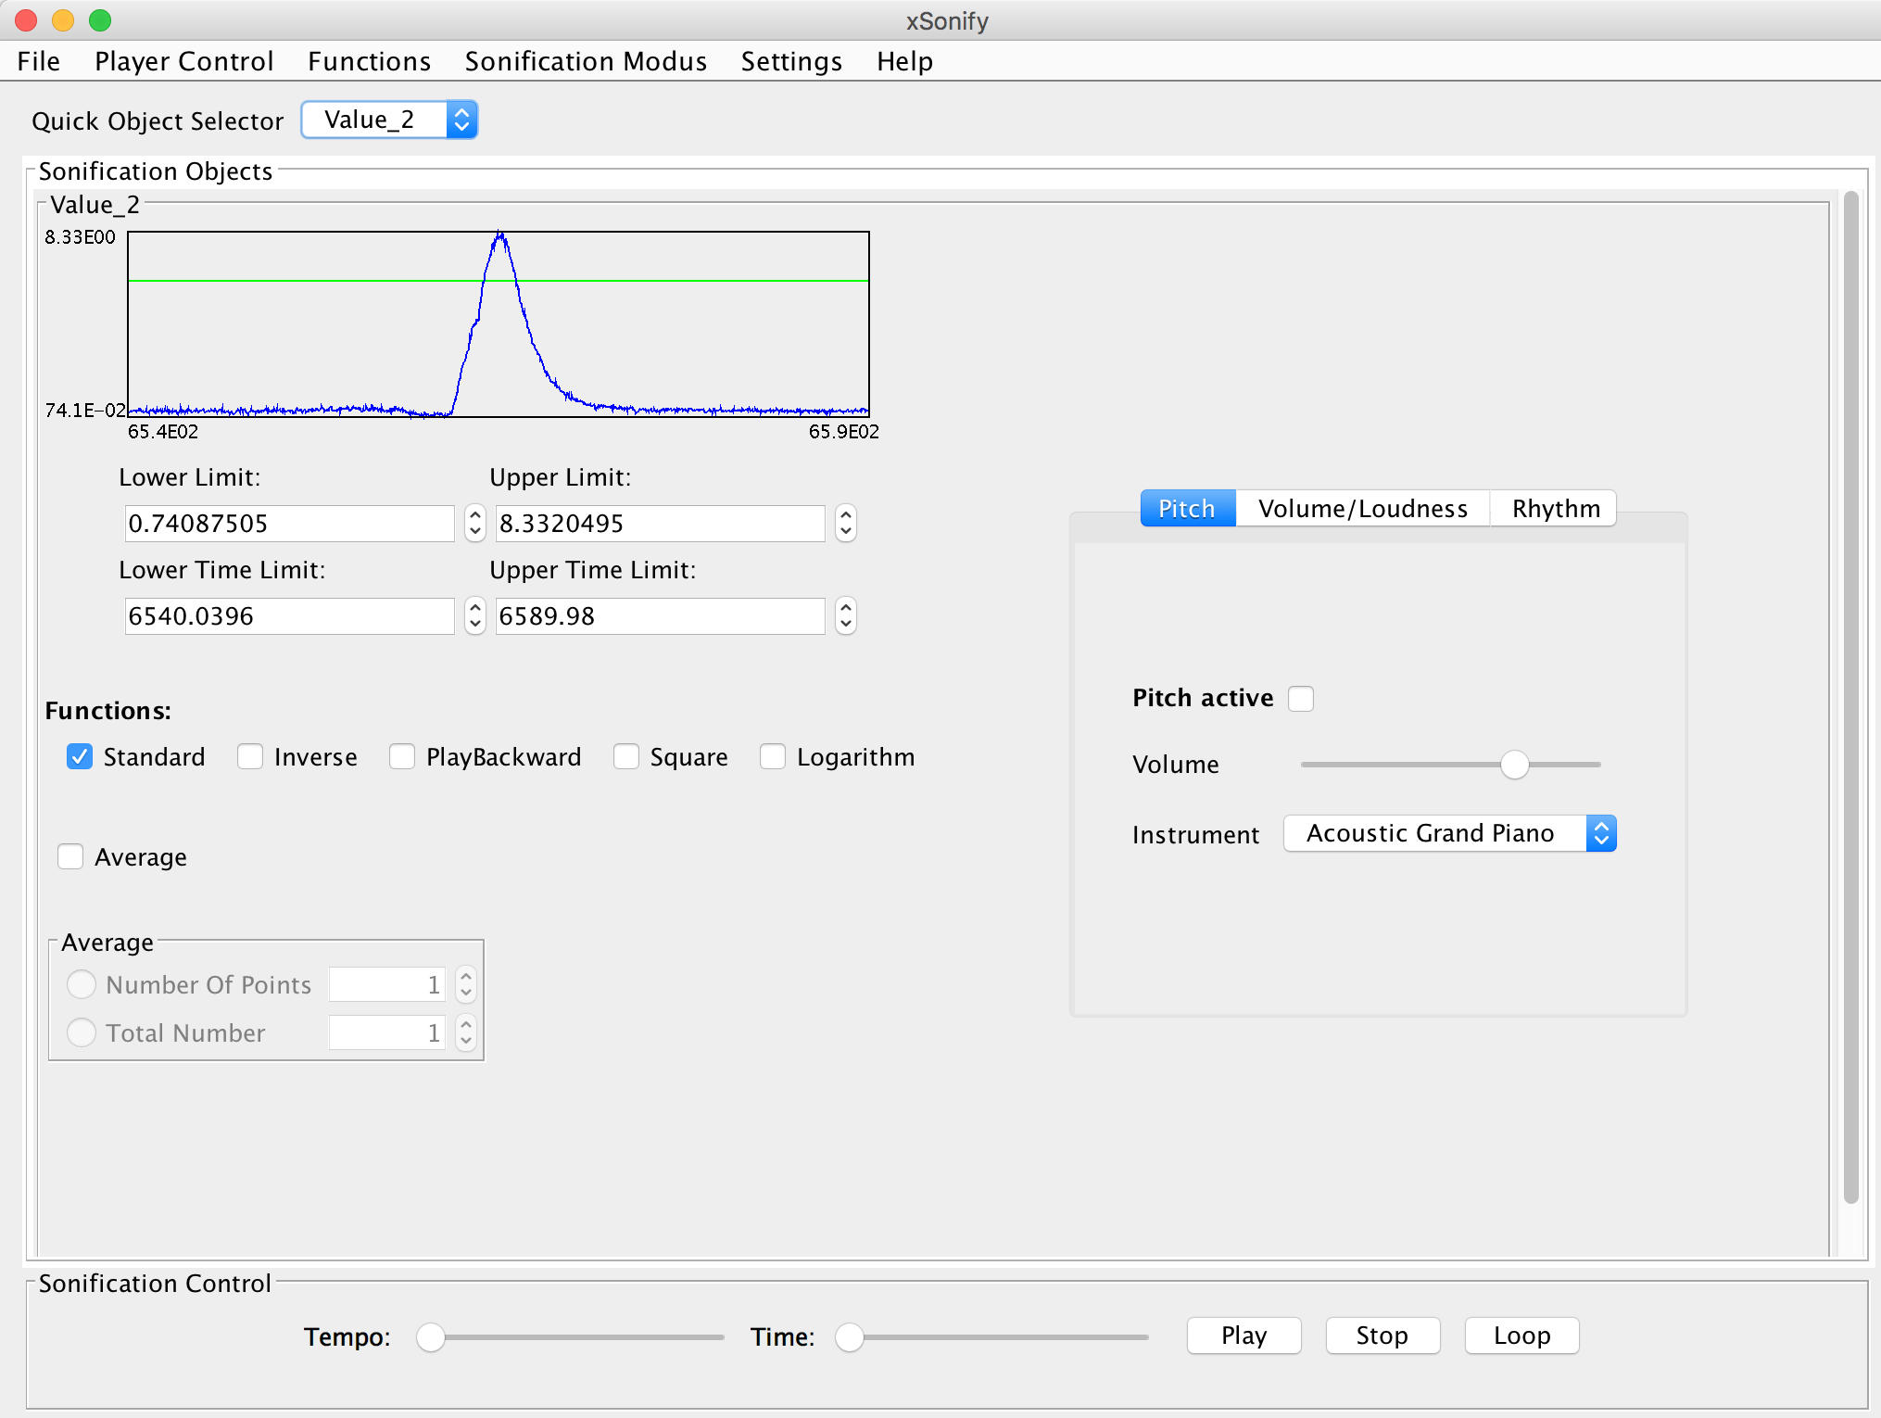
Note.
Yes, I did just play radio data for you
No, astronomers don’t actually listen to radio data**
**Except!!!
Sonification: low-vision/blind astronomers render data auditorily
Can also 3D print!
Astronomers need artists’ help to render data in new, accessible ways!
Notes:
X-sonify: https://www.cfa.harvard.edu/sed/projects/star_songs/pages/xraytosound.html
3d printed model, Salvatore Orlando: http://chandra.harvard.edu/deadstar/sn1987a.html

Slide 21
Neutron stars in pairs
Just like white dwarfs accreting from companions, neutron stars can, too
Material falling in releases a lot of gravitational potential energy
Not because of the distance, but because of the G! (recall, PE = mgh)
Accretion disk so hot, emits X-rays
Called an X-ray binary
A pair of neutron stars could exist, orbit each other; even merge:
resulting energy release could form elements heavier than iron: more energy involved than in a massive star supernova
lots of neutrons around, rare elements could be formed
models show most of rare-earth elements in universe (like gold!) produced by neutron star mergers
Notes:
https://www.cosmos.esa.int/web/cesar/x-ray-binaries-monitoring

Slide 22
Black holes
So far, degeneracy pressure has thwarted gravity- can gravity ever win?
Rev. John Michell (1783), Pierre-Simon Laplace (1796) wondered: do “Dark Stars” exist? So small, escape velocity ~ speed of light?

Slide 23
Escape velocity
Speed needed to escape an object’s gravitational pull
Examples:
Earth: V_{esc} = 27,000 miles/hour (11 km/s)
Sun: V_{esc} = 1.4 million miles/hour (600 km/s)
Keeping their masses the same, for v_{esc} to be the speed of light,
Earth’s radius R ~ 1 inch
Sun’s radius R ~ 2 miles

Slide 24
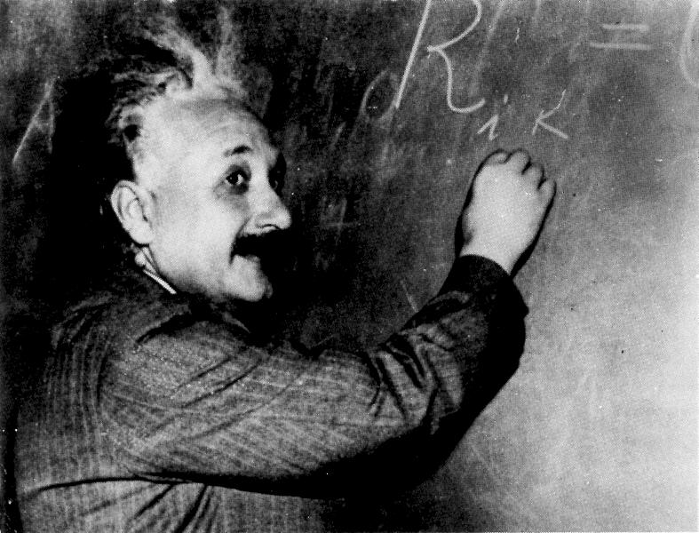
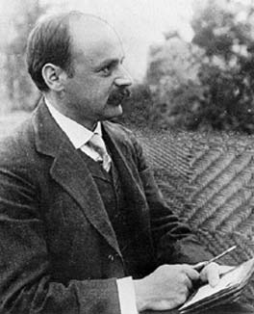
Historical note
1915: General Relativity, Einstein’s Theory of Gravity
1916: Karl Schwarzschild’s discovery of black holes in General Relativity
~1960s: Black holes understood and generally accepted
1967: term “black hole” coined by John Wheeler
Mid-1990’s-present: Prof. Andrea Ghez observing stars’ orbits around Milky Way (supermassive) BH

Slide 25
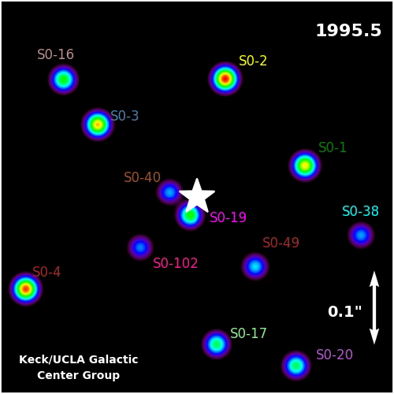
Our friendly Milky Way BH
Notes:
http://www.galacticcenter.astro.ucla.edu/animations.html

Slide 26
Black holes
The neutron star limit is ~3 M☉
A collapsing stellar core >3 M☉ becomes a black hole
The event horizon is where the escape velocity = c
Schwarzschild radius: 2GM/c²
For a 10 M☉ black hole, it is 30 km
The center of a black hole is called a singularity; this is where all the black hole mass resides
If the escape velocity is ~c, gravitational force is so strong, not even light can escape
Notes:
http://astrosun2.astro.cornell.edu/academics/courses/astro201/bh_structure.htm

Slide 27
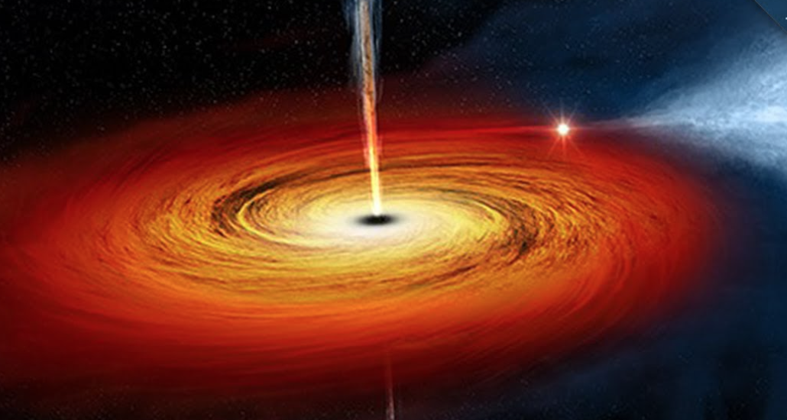
Black hole myth-busting
BHs are not cosmic vacuum cleaners: only inside the event horizon is matter pulled inexorably inward
Far away from a BH, gravity is no different than for any other object with the same mass
If a BH were to replace the sun, the orbits of planets, asteroids, moons, etc., would be unchanged (though it would get really really cold)
Notes:
Yep, black holes can have accretion disks, just like stars, white dwarfs .. Physics is the same ☺

Slide 28
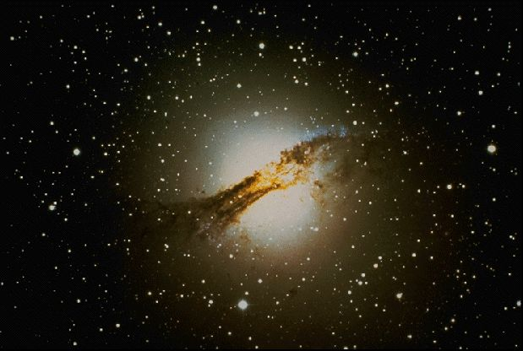
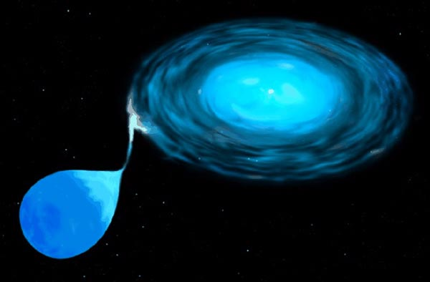
Where to find black holes?
Galaxy Centers
Binaries
Millions of solar masses (“supermassive” black holes)
Generally 1 per galaxy
We don’t know how they form
Likely millions of black holes per galaxy of ~10 M☉ or more
Formed via massive star collapse
One example: Cygnus X-1: 18 M☉ + unseen ~10 M☉ object

Slide 29
Black holes: concluding thoughts
The theory of relativity predicts that time should run more slowly as the force of gravity grows stronger
The light coming out of a strong gravitational field should show a gravitational redshift (recall: neutron stars do this, too)
A body falling through the event horizon will be stretched and squeezed
Black holes produce among the most dramatic and energetic phenomena in the universe
Gamma ray bursts
Black hole-black hole mergers
Galactic center black holes accrete, drive energetic outflows
Notes:
For now…

Slide 30
Lecture recap
A star’s mass determines its fate.
Low-mass stars (0.5 – 5 M_{sun}) end their lives as white dwarfs expelling planetary nebulae. The core mass does not exceed 1.44 M_{sun}
Intermediate-mass stars (5 – 10 M_{sun}) end their lives exploding as supernovae, leaving neutron stars behind. The core mass does not exceed 3 M_{sun}
High-mass stars (M > 10 M_{sun}) end their lives as exploding as supernovae, leaving black holes behind. The core mass exceeds 3 M_{sun}
Binary systems with a white dwarf and mass transfer may end up as supernovae, if the white dwarf mass becomes higher than 1.44 M_{sun}

